Slide 1
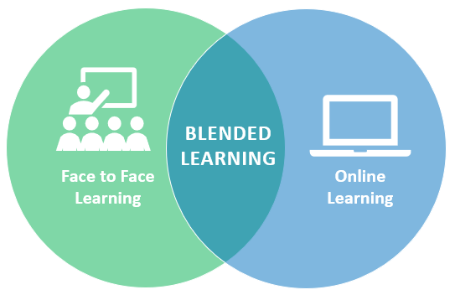
Blended Learning…a Demonstration
Judith J. Scott

Slide 2
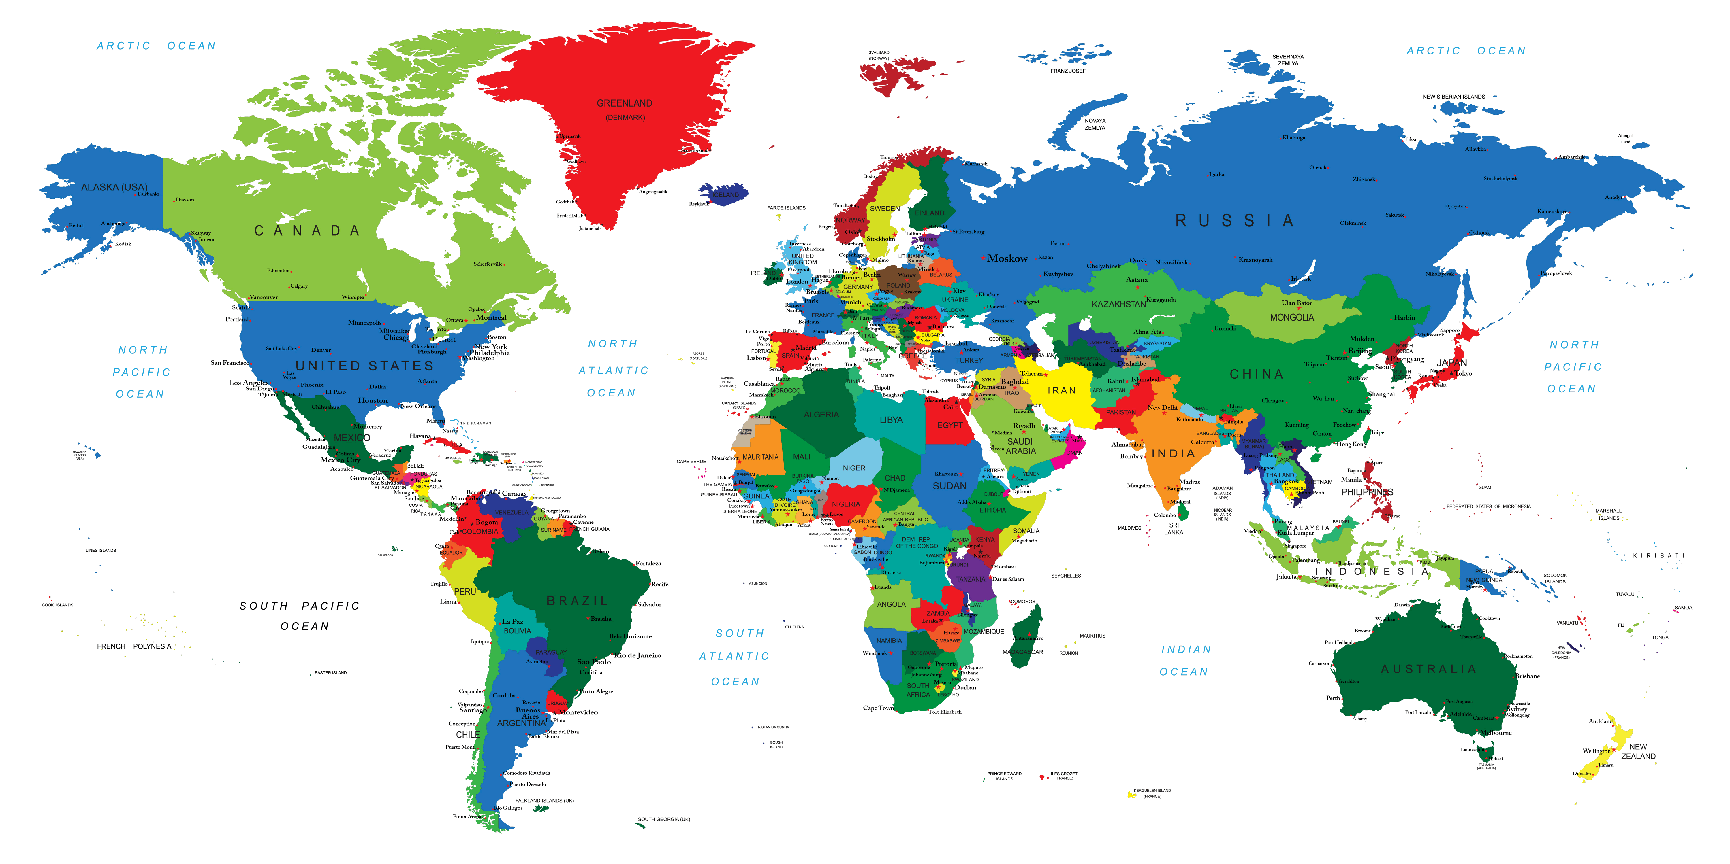
Today’s Objective
Understand Blended Learning/Demonstrate its use
Notes:
Good Morning, So happy to be here with you. I am Judith Scott and I’m here to demonstrate Blended Learning. Many of you know I’m passionate about training and I’m passionate about the many creative ways we can deliver training not just locally but world wide.
I think my interest began with Adobe Connect years ago, I saw the possibilities to connect with students any where in the world as long as they had an internet connection.
I’m have 3 classes to go before I complete my Masters in Distance Education and E learning…and DE is being used around the world to teach agriculture,health care, and computer skills everywhere on the planet to farmers in Africa, Health care in China and computer skills in Europe among other things.
Training is full of terms and terminology…Blended learning it’s different, it’s a verb.
Blended learning is a verb…it’s what you do and how you do it.
It encompasses the various ways we can deliver and engage our learners.
It can be used effectively for all types of learning : soft skills, technical skills and skills that require hands on application.
Please take out your cell phones….that’s right you heard me correctly. Please take out your cell phones.

Slide 3
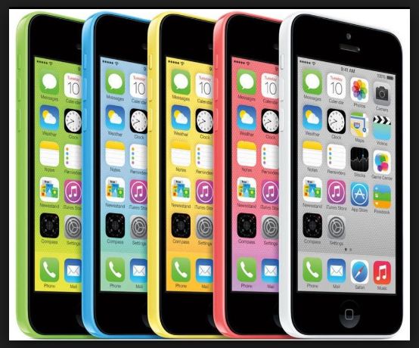
Take Out Your Cell Phone
Notes:
Please take out your cell phones
This is the one time when you get to take out your cell phones.
Table 1 would you please look up the definition : Distance Education
Distance
Table 2 - E-learning
Table 3 - Blended learning

Slide 4
The Changing Landscape
Distance Education
E-Learning
Blended Learning
Notes:
Education is changing
Table 1 would you please look up the definition : Distance Education
Distance
Table 2 - E-learning
Table 3 - Blended learning
Distance Education – is what it implies….the student and teacher are in different locations
E-learning – To learn via the web or through some computer mean

Slide 5
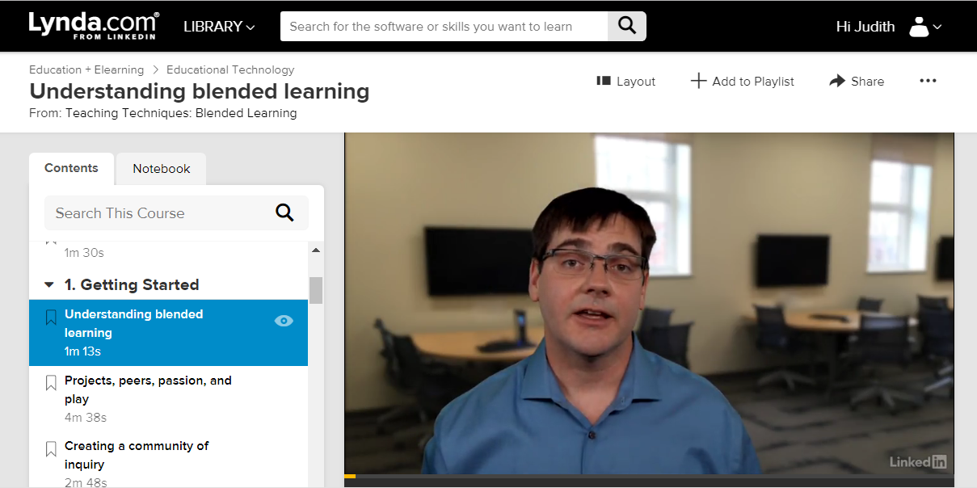
Blended Learning - Lynda.com
https://www.lynda.com/Educational-Technology-tutorials/Understanding-blended-learning/424004/471377-4.html?srchtrk=index%3a1%0alinktypeid%3a2%0aq%3aBlended+Learning%0apage%3a1%0as%3arelevance%0asa%3atrue%0aproducttypeid%3a2
Notes:
While you’re doing that…Let’s watch this brief clip.

Slide 6

How Blended Learning is Delivered
Prework
Synchronous
Asynchronous
In-person
Virtual Delivery
Hard Copy/Soft Copy Resources
Notes:
Blended courses (also known as hybrid or mixed-mode courses) are classes where a portion of the traditional face-to-face instruction is replaced by web-based online learning.
Prework – Work done prior to class
Synchronous – working together at the same time
Asychronous – working on your own but moving forward – not working together at the same time.
In-person – Classroom or a breakroom
Virtual delivery – adobe connect or YouTube
Hard copy / soft copy resources printed material / electronic data

Slide 7
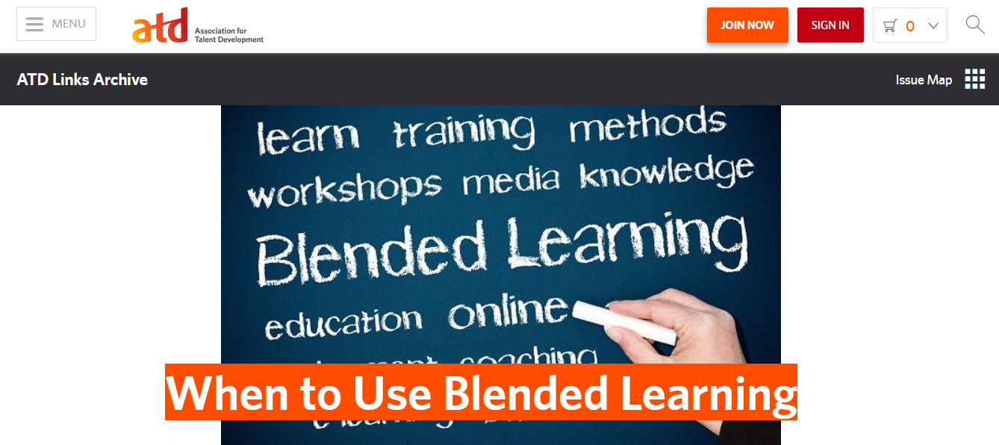



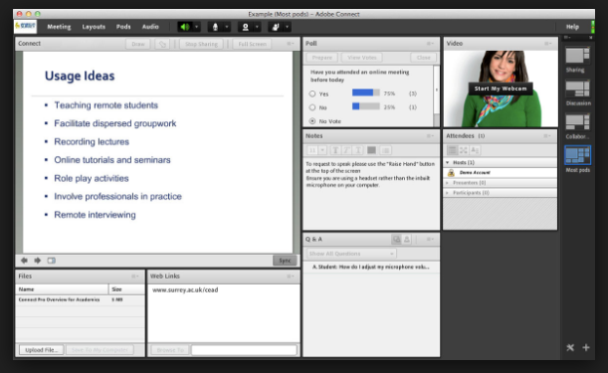
Mix It Up

Slide 8

Let’s Step into the Future
Notes:
Stepping into unknown territory is never easy….But instead of being afraid let’s take that voyage into unknown territory. Let’s take the leap and bring our training in to the future. Let’s take our training into the next generation.

