Slide 1



Business Writing
OMDE DETT 607 / April 2019
By Judith J. Scott
Notes:
Greetings I am Judith Scott and Welcome to this Presentation of the Instructional Design Story Board for the course -- Business Writing. This presentation will cover the design and development of a Business Writing course for working professionals.

Slide 2
Table of Contents
Course overview
Goals
Learning objectives
Course design
Module 1 – Review of grammar, punctuation and word usage
Module 2 – Effective writing
Module 3 – Plan before you write
Module 4 – Essentials of effective writing
Module 5 – The documents you write
Module 6 – Ensuring quality
Course Rubric
Conclusion
References
Notes:
Today will we cover the course overview, goals learning objectives and course design for the course. We will also review each module of the course and the course rubric.

Slide 3
Course Overview
BUSINESS WRITING is intended to build the knowledge and skills participants need to confidently communicate in writing to various audiences in an effective and, when appropriate, influential way.
Notes:
Business Writing is designed for employees who are proficient in the basics of writing but may need a refresher in grammar and mechanics. Students will also learn to use pre-writing techniques so that their writing has clarity and conciseness while meeting the needs of the directorate. Through interactive activities and discussions, participants will learn how to create a unique writing style for various types of business correspondence. They will also practice writing techniques and apply them to writing emails, memos, reports and proposals. Students will also learn to self-edit their material as how to constructively accept feedback from others.

Slide 4
Goal
BUSINESS WRITING is intended to build the knowledge and skills participants need to confidently communicate in writing to various audiences in an effective and, when appropriate, influential way. It is designed for employees who are proficient in the basics of writing but may need a refresher in grammar and mechanics. Good goal statement.

Slide 5
Learning Objectives
Identify the components that good writers include in writing
Plan documents by identifying their purpose, audience, thesis and scope
Use outlining tools to identify key topics and subtopic
Write effective sentences that provide pertinent information to readers
Build paragraphs that include topic sentences, supporting details, and transition phrases
Complete both substantive edits and line edits.
Notes:
The objectives are simple. The course will build the knowledge and skills participants need to confidently communicate to various audiences in an effective and, when appropriate, influential way. It is designed for people who are proficient in the basics of writing, including grammar and mechanics. Even though we will review these topics.
Participants will learn to use pre-writing techniques that give their writing clarity and conciseness while meeting the needs of the audience.
Through interactive activities and discussions, participants identify how to create a unique writing style for various types of business correspondence.
Participants also learn best practices for self-editing their work as well as seeking feedback from others to ensure effectiveness.

Slide 6
Course Design
The content for the Business Writing course will be presented in six modules (2 per month) over a year via webinar and the Learning Management System (PALMS). We will also use online assessments for testing and for preliminary evaluation. The writing skills component of the course will be taught synchronously and asynchronously.
Notes:
The course will we taught to participant synchronously and asynchronously via webinar and through the agency LMS PALMS.

Slide 7

Gagne’s 9 Events of Learning
Event | Process
Gain attention | What’s In It For Me (WIIFM) Share stories of the horrors of bad writing . Incorporate lighthearted material/text like “Quick and Dirty Grammar Tips”.
2. Inform learners of the objectives/directions | Connect (WIIFM) to objectives and value of writing to their career. Share real life scenarios.
3 .Simulate recall of prior learning | Students will create mind maps of everything that is involved in writing. They will circle their weaknesses and observer that everyone needs help with something.
4. Present the content | Lectures, case studies, readings and hands on activities and exercises
Notes:
The course is developed based on Robert Gagne’s 9 event of learning. We are confident that adhering to the 9 events will aid us in developing a fully formed course.

Slide 8
Gagne’s 9 Events of Learning
Continued
Event | Process
5. Provide learning guidance | Peer coaches, cheat sheets, topic specific reference sheets
6. Elicit performance | Hands on practice to apply the lessons.
7. Provide feedback | Specific feedback to each student on what they need to work on and what they are doing well. Talk about past writing experiences.
8. Assess performance | Quizzes, projects (written assignments)
9. Enhance retention and transfer (closure) | Engage home office for specific assignments. Engage the home stakeholder for input.

Slide 9
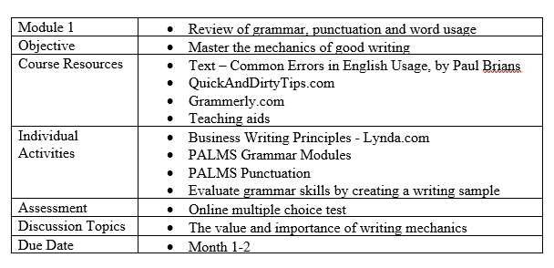
Module 1
Review of grammar, punctuation, and word usage
Notes:
Each module has a brief sample exercise the first one is shown here.

Slide 10
Grammar Assessment
Choose the correct word in parentheses to write grammatically correct sentences.
1. Please give all the information you collected to John and (I, me) by this evening.
2. Everyone of the students (is, are) working in the library.
3. (Whoever, Whomever) possesses the most knowledge should be put in charge.

Slide 11
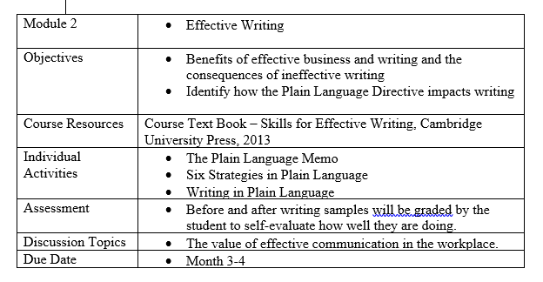
Module 2
Effective Writing

Slide 12
Effective Writing
Rewrite Outdated Sentences
Directions – Review the sentences below. Think of how to rewrite each sentence with a more modern wording.
The aforementioned appendix is being forwarded under separate cover.
Matter discussed herein is of a confidential nature.
Allow me to point out the merits of our plan.

Slide 13
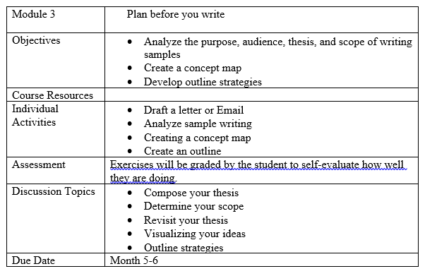
Module 3
Plan Before You Write

Slide 14
Plan Before You Write
Directions
Locate a poorly written email either by you or others.
Carefully read the email, gleaning what you can about the situation from the text.
Determine how you could make the emails more effective.
Review your thoughts and rewrite the email.

Slide 15
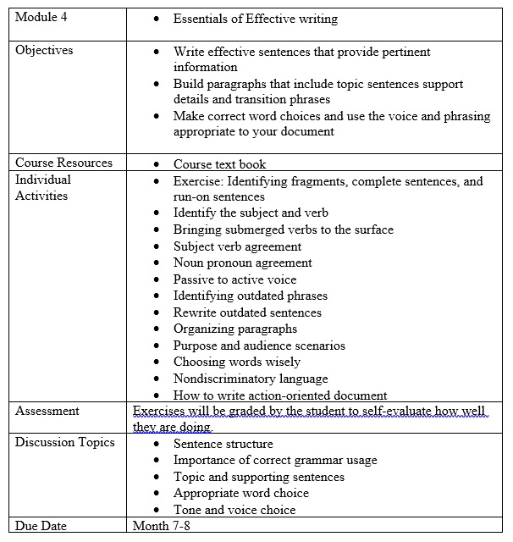
Module 4
Essentials of Effective Writing

Slide 16
Essentials of Effective Writing
Passive to Active Voice
Directions: Review the following sentences and change the passive voice to active voice
These charts were developed to depict the results of our survey
The movie Jaws was directed by Steven Spielberg
In order for payment to be distributed, invoices must be submitted by your on Monday.

Slide 17
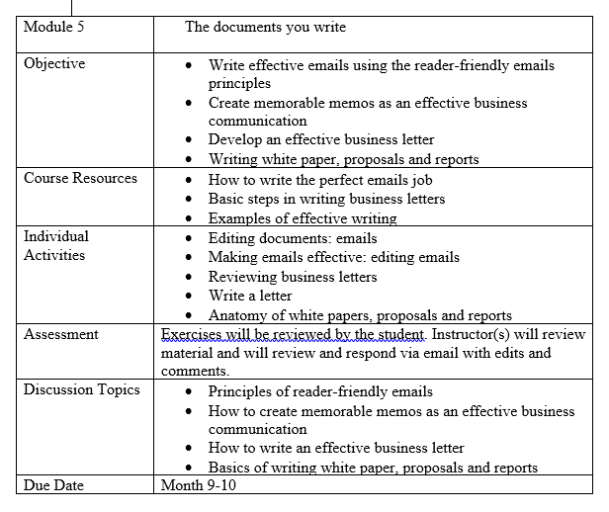
Module 5
The Documents You Write

Slide 18
The Documents You Write
Purpose and Audience Scenario
Directions
Choose a purpose and audience scenario from the following table or make up your own.
Choose a document type.
Create a thesis.
Decide on your scope.
Write a two-to-three paragraph writing sample based on your Purpose, Audience and Document Type.

Slide 19
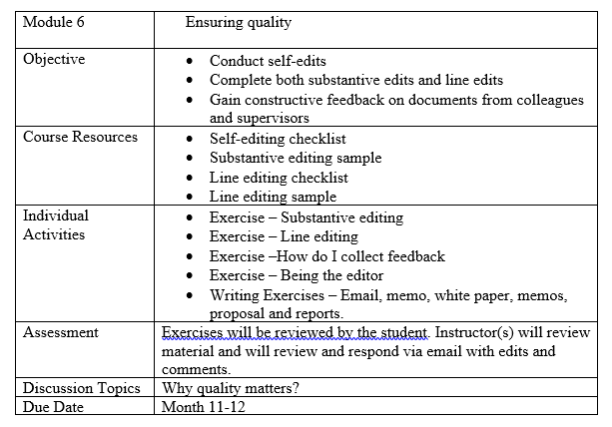
Module 6
Ensuring Quality

Slide 20
Ensuring Quality
Directions: Grab some of the writing you have done in this course. Ask yourself:
Did I follow my outline?
Did I include the ideas I wanted to include?
Did I develop those ideas properly and I a logical order?
Did I achieve my purpose?
Did I consider all of the feedback I received?

Slide 21
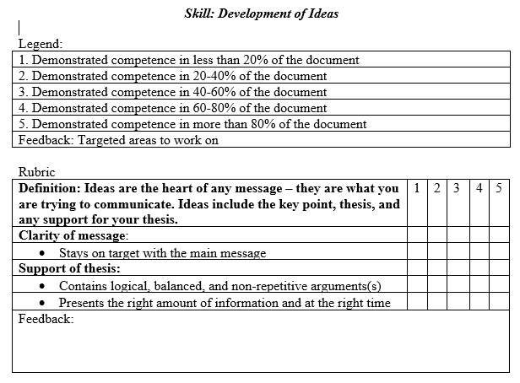
Course Rubric
Notes:
We have created a course rubric to ensure the learning objectives are met.

Slide 22
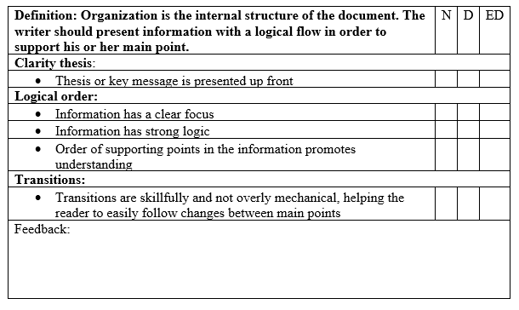
Rubric continued…

Slide 23
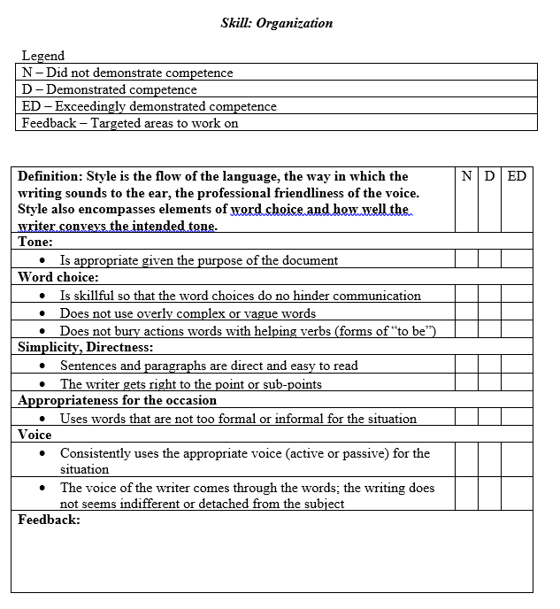
Rubric continued…

Slide 24
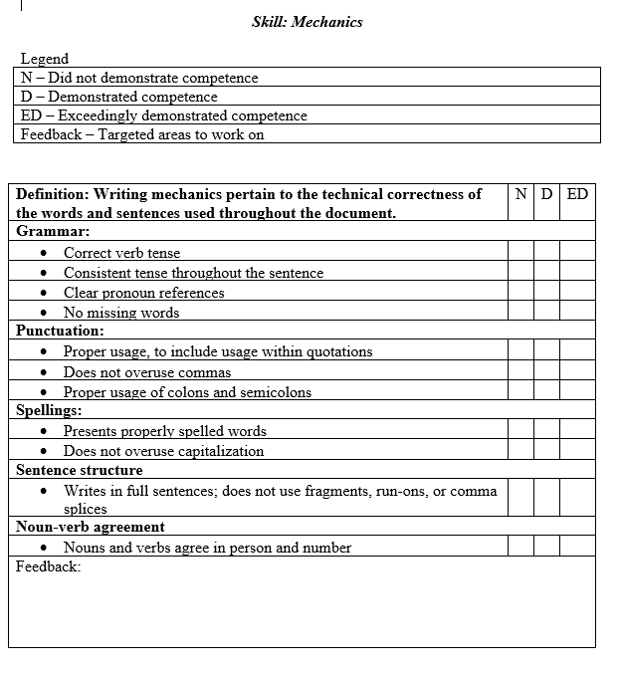
Rubric Continued

Slide 25
Conclusion
This storyboard presents the components for the FDNS Business Writing course as designed by the Training Division.
Notes:
This course was requested by the Associate Director. The class begins with covering the mechanics of writing: grammar, punctuation and word usage for two months. After that, the class will cover organization, outlining and writing various business documents. The first iteration of the course will function as a pilot and will have 20 students participating nationwide. After the pilot is evaluated using the Kirkpatrick Model, changes will be implemented to incorporate the feedback gathered during the evaluation process. The full course, when formally rolled out, will run for a full year beginning FY-20-FY-21. The remaining time in FY-19 will be used to launch the pilot.

Slide 26
Any Questions or Feedback
Scott.Judith@gmail.com

Slide 27
References
All about addie. (2015). Retrieved from https://www.td.org/newsletters/atd-links/all-about -addie
Croxton, R. A. & Chow, A. S. (2015). Using ADDIE and systems thinking as a framework for developing a MOOC: A case study. Quarterly Review of Distance Education.
Dabbagh, N. (2007). The online learner
Pappas, C. (n.d.). Top 7 instructional design theories & models for your next elearning course – e-learning industry. Retrieved from https://elearningindustry.com/top-instructional-de sign-theories-models-next-elearning-course

